Slide 1
Teaching Programming Fundamentals with Candy Catch
Anel Coralic, Austin Lanier, Carl Mickiewicz, Derek Phung

Slide 2
Who Are We?
Anel Coralic
Austin Lanier
Carl Mickiewicz
Derek Phung

Slide 3
What is TAP
The Technology Ambassadors Program (TAP) focuses on community outreach. This award-winning program also addresses a need to increase the number of students who persist in an IT major or minor, particularly those underrepresented in computing. TAP is a service-based learning course where students design a project to teach IT concepts.

Slide 4
Pre-Survey

Slide 5
Candy Catch
https://scratch.mit.edu/projects/481519033/

Slide 6
Programming Concepts
If-Then Statement: An if-then statement is a concept that specifies the execution of an action when a condition is true, or another action is done. Example: “If the "d" key is pressed, then the user will move 10 spaces right”.
While/Forever Loop: All the code in the loop will execute forever as long as the program is running. A forever loop allows the candy in our game to constantly fall, rotate, and re spawn at the top of the screen.

Slide 7

What is Scratch
Scratch is a block-coding based software to introduce basic coding concepts to beginners through interactive games.

Slide 8
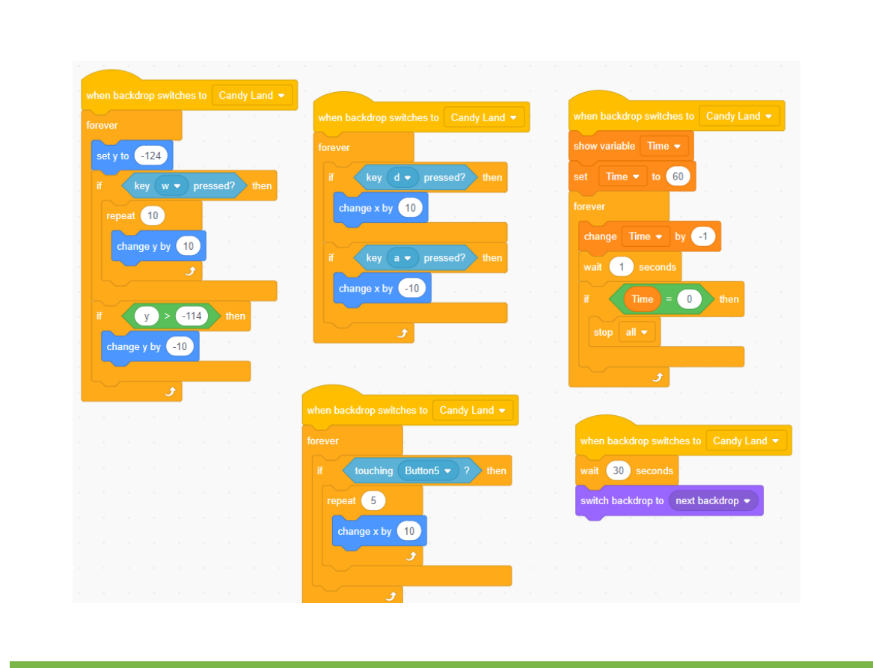
Block Coding
Block Coding utilizes a drag-and-drop learning environment where programmers use blocks to construct basic programs.

Slide 9
Scratch Link
https://scratch.mit.edu/projects/507324213

Slide 10
Post Survey

